Slide 1

Nextor: resurrecting MSX -DOS
Néstor Soriano
www.konamiman.com
Notes:
Thanks for coming. I’ll introduce myself: I’m Néstor Soriano, .NET developer; at night I wear mask and cape and I’m Konamiman, a MSX developer.
Marce, the president of RetroMallorca, asked me to give a talk about Nextor. And one doesn’t simply say “no” to Marce.
What’s Nextor, besides a Word that I should be ashamed to say according to my wife?

Slide 2
What is Nextor?
Nextor is a fork of MSX-DOS 2.31
…and what is MSX-DOS?
MSX-DOS is the “official” operating system of MSX computers
…¿ MSX ?
Notes:
A fork is a piece of software developed from the sources of another existing software, but independently.

Slide 3
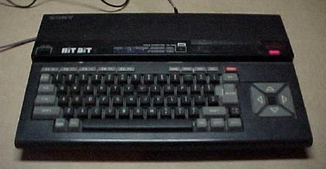
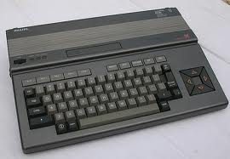
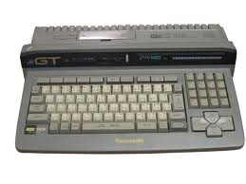
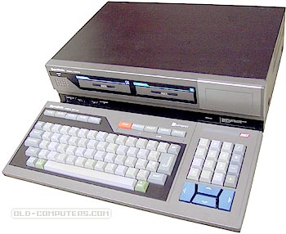
The MSX system
Standard for home computers
Notes:
In the early 80s the home computing was quite chaotic, with a lot of incompatible systems. Then the decisión was taken to create MSX: a standard that any maker could adopt, which ensured compatibility for hardware and software.

Slide 4
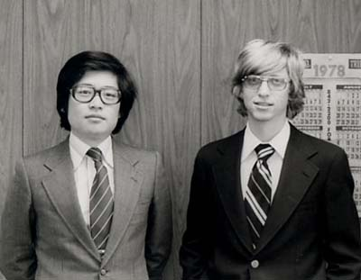
The MSX system
Standard for home computers
Designed by Kazuhiko Nishi (ASCII Corp), backed by Microsoft
Notes:
Kay Nishi, vicepresident of Microsoft for Asia from1979 to 1986.
President of ASCII Corporation (publishing house first, videogame maker later, multimedia, etc)
MSX based on the Spectravideo SV318

Slide 5
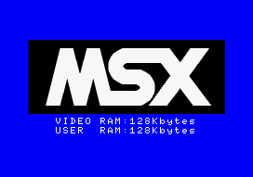
The MSX system
Standard for home computers
Designed by Kazuhiko Nishi (ASCII Corp), backed by Microsoft
Z80 based, produced from 1983 to 1993

Slide 6
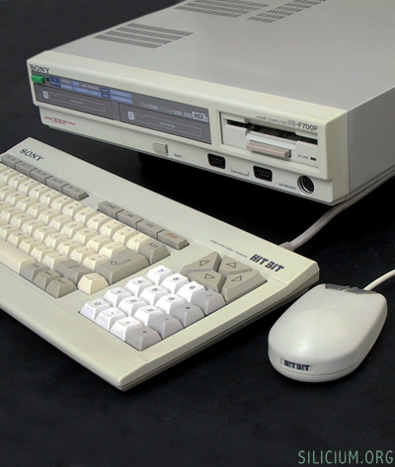
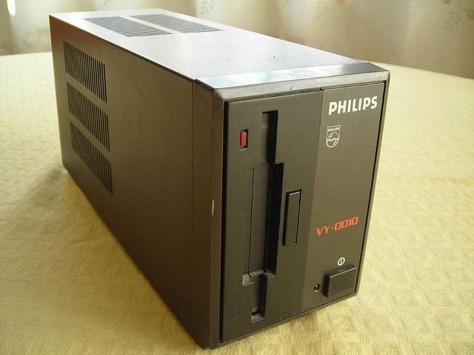
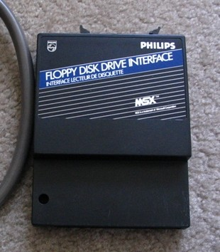
MSX-DOS 1.0
Released in 1984 by ASCII Corp.
Distributed together with floppy disk drives (external at first, integrated later)
Externally it is a clone of MS-DOS 1.0
Supports devices up to 16MB in size (3 sec/cluster)
Notes:
The first MSX models didn’t have a disk drive, but by 1984 the first ones were available.
DOS 1 stores the whole FAT in memory (up to 1.5K)
Trivia: MSX was the first computer to use 3.5” floppies (or one of the first ones at least)

Slide 7
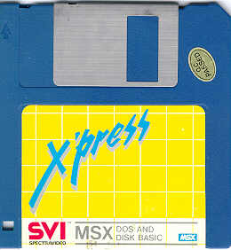
Parts of MSX-DOS
16K ROM
Kernel
Disk BASIC
Disk drive driver
System files
MSXDOS.SYS
COMMAND.COM
Notes:
2 reasons for ROM:
In a MSX, all the code that has to run at boot time must be in a ROM.
MSX computers have little memory, they can’t load the whole SO in RAM.

Slide 8

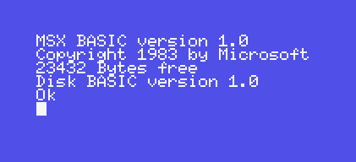
Two working modes
Command interpreter
Requieres 64K RAM
Requieres MSXDOS.SYS and COMMAND.COM
Maps 64K RAM in memory
Disk BASIC
Requires 16K RAM
Activates when MSXDOS.SYS is not available, or if memory is less than 64K RAM
Maps 32K RAM in memory
Notes:
Boot process: the ROM checks if there are 64K of RAM available, then checks if a floppy disk with MSXDOS.SYS is present, then boots the command interpreter. Otherwise it boots Disk BASIC.

Slide 9
MSX-DOS 1 commands
BASIC ........... jumps to MSX DISK-BASIC COPY ............ copies a file DATE ............ displays or modifies date DEL ............. deletes a files DIR ............. displays a list of files FORMAT .......... formats a disk MODE ............ modifies screen width PAUSE ........... pauses a batch command operation REM ............. puts a comment in a batch command REN ............. renames a file name TIME ............ displays or modifies time TYPE ............ prints the contents of a file VERIFY .......... turns on/off the verify mode
Notes:
Commands for file management (COPY, DEL, DIR, REN, TYPE)
Commands for environment configuration (BASIC, DATE, TIME, MODE, VERIFY)
Commands for .bat files (REM, PAUSE)
FORMAT to format disks

Slide 10
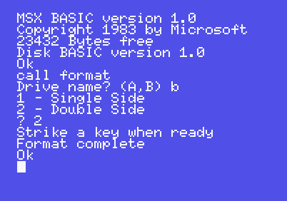
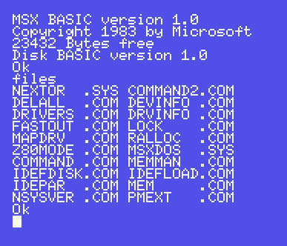
MSX-DOS 1 commands (Disk BASIC)
LOAD/SAVE/BLOAD/BSAVE/RUN
OPEN/CLOSE/GET/PUT/LOC/
LOF/INPUT/EOF
KILL/NAME/COPY/FILES/DSKF
CALL FORMAT
CALL SYSTEM
DSKI$/DSKO$
Notes:
LOAD etc: to read/write executable files
OPEN etc: to read/write data files
KILL etc: for file management

Slide 11
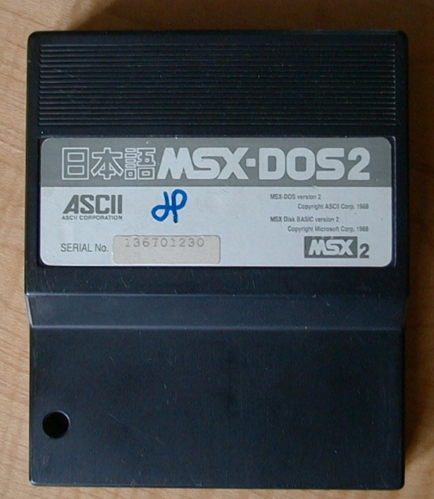

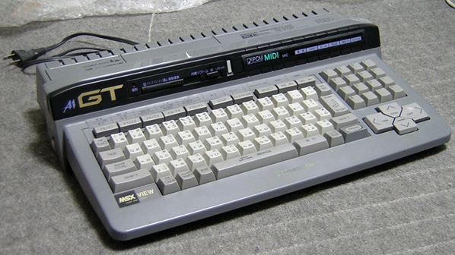
MSX-DOS 2.20-2.31
Released in 1988
Externally similar to MS-DOS 3.x
Distribution:
v2.20: in a cartridge (kernel only, no driver)
v2.3x: Integrated in
(1990)
Notes:
Versions 2.0 and 2.1 were experimental.

Slide 12
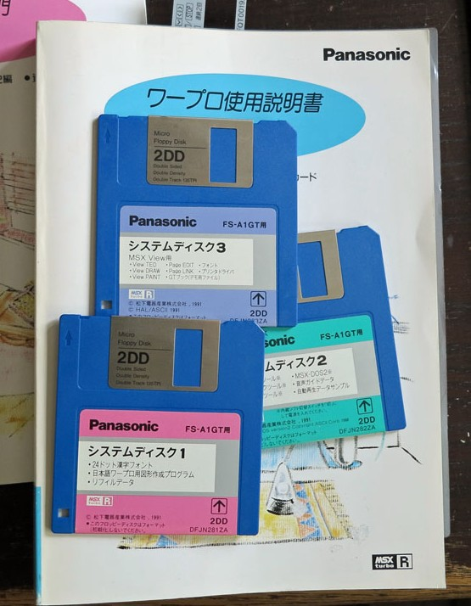
Parts of MSX-DOS 2
64K ROM
Kernel
Disk BASIC
Floppy disk driver (Turbo-R)
MSX-DOS 1 kernel (Turbo-R)
System files
MSXDOS2.SYS
COMMAND2.COM
Requires MSX2
Requires 128K RAM
16K for code
16K for data
Notes:
Files end with “2” so that versions 1 and 2 can be placed in the same disk (it was common to boot in DOS 1 mode because some programs didn’t work in DOS 2 mode as they accessed RAM directly by ports)

Slide 13
What was new in MSX-DOS 2?
For the user…
Subdirectories
RAM disk
Environment variables
More rational usage of memory
Support for devices up to 32MB in size
For the developer…
Basic memory management (allocation of 16K blocks)
Easier file handling (File Handles vs File Control Blocks)
Error handling
Hook to capture disk errors
Hook for application termination
Notes:
In DOS 1, any error caused the “Abort, Retry, Ignore” message to appear and this couldn’t be changed.

Slide 14



How are devices mapped in MSX-DOS?
Controller 1
Device 1
...and MSX-DOS maps them to drive letters directly and in the same order.
Drivers declare a fixed number of devices…
Device 2
Controller 2
Device 1

Slide 15

So in sum…
MSX-DOS is a wonderful operating system to work with floppy disks.
But…

Slide 16
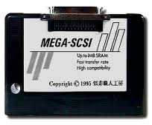
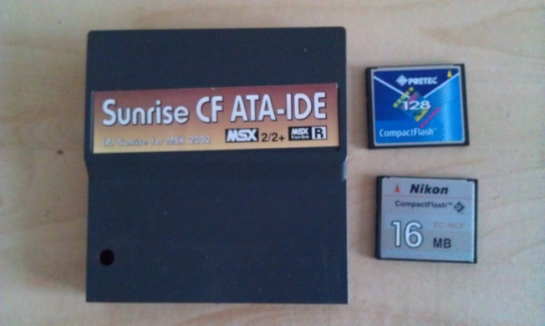
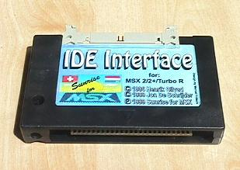
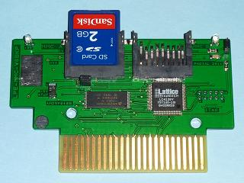
Amateur storage controllers
They include a ROM with the MSX-DOS 2 kernel + a driver
1990s: Hard disks, ZIP disks
2000s: CF, SD cards
Notes:
We the MSX users can’t stay with our arms folded, and when MSX was abandoned by makers, we started to build our own storage conrollers..

Slide 17

Problems when going beyond floppy disks…
32MB/volume limit (FAT12, 16 bit sector numbers)
Lack of documentation for writing device drivers
Direct mapping of devices to drive letters, not configurable, no support for partitions
Handling non-block devices (CD-ROM…) is impossible

Slide 18

…and necessity of managing on one’s own.
Infinite partitions to handle high capacity devices
External patches for FAT16 support
They are installed a posteriori, so it is not posible to boot from a FAT16 volume
Reverse engineering of ROM for developing drivers
Constant reinvention of the Wheel for each new controller:
Custom internal partition handling
Custom tolos for mapping partitions to drive letters
Custom FDISK
Black magic for supporting CD-ROMs

Slide 19




: Old war story!
More details here:
http://bit.ly/1lNFpd5

Slide 20

The main goal of Nextor
Make life easier for the user, and especially for the developer, of storage controllers for

Slide 21

What does Nextor offer to users?
Works on MSX1
Full and native support for FAT16
Up to 4GB per volume
Boot from FAT16 volumes
FDISK integrated (BASIC command)
Device to drive letter mapping management
Automatic (at boot and when detecting a change)
Manual (with a tool)
Concept: fixed vs removable devices
Nextor doesn’t poll fixed devices for changes
Drive letters assigned to removable devices can be locked
Notes:
Automatic mapping: one drive letter for each device that has at least one FAT12 or FAT16 partition. Partitions having a NEXTOR.DAT file in the root directory have preference.
MSX-DOS polls continuously for device changes before accessing them.

Slide 22

…and for the developer?
A standard and documented system for developing device drivers!
Detailed documentation for the driver structure
Source code of a scaffold driver to start working
Procedure to generate a ROM with kernel + driver
Generation tool (source in C, Windows executable)
Fully documented procedure for manual generation
Documentation for the new system calls
Notes:
The new system calls allow primarily to manage drive letter mappings and to obtain information about the existing devices and partitions.

Slide 23

What routines must implement a Nextor driver?
Enumerate devices
Name
Type (block/other)
Capacity
Fixed/removable
Read and write sectors
Provide state information (changed/not changed)
…and that’s it. Nextor handles partitions and mappings!

Slide 24
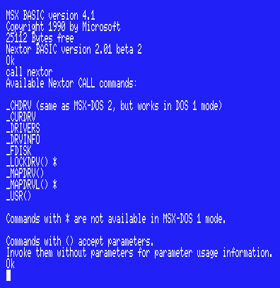
Nextor commands
Notes:
Look at the boot message. It’s cool!

Slide 25
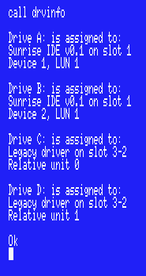
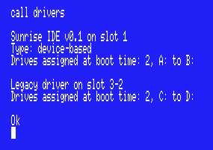
Nextor commands

Slide 26
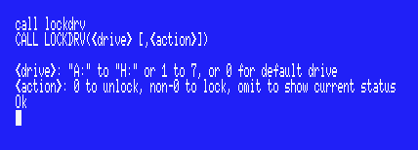
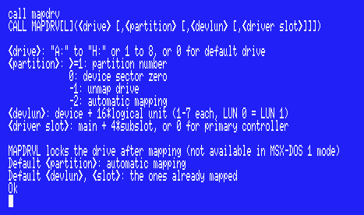
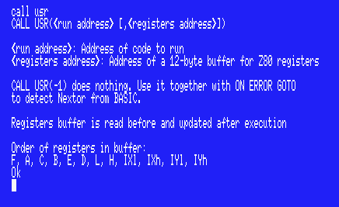

Nextor commands

Slide 27
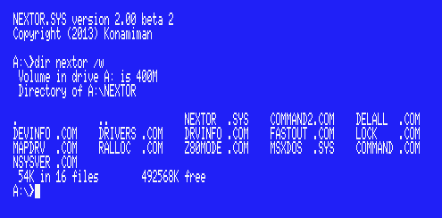
Nextor commands
Notes:
NEXTOR.SYS instead of MSXDOS2.SYS
The free space?? Because COMMAND 2.40 supports FAT16.

Slide 28
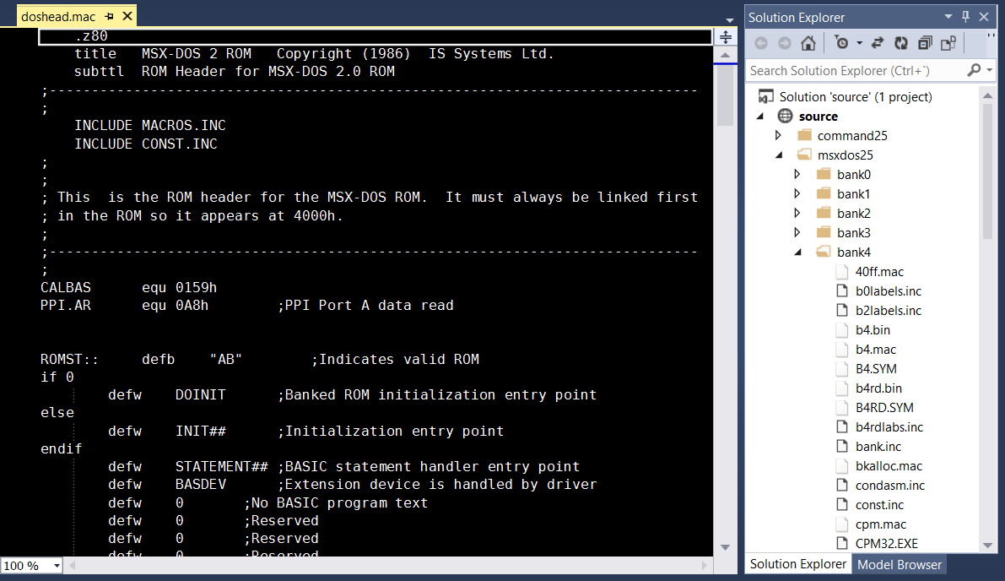
Tools used for the development of Nextor
Visual Studio for editing source code (“Open web site”)…
Notes:
I can see the files and folders structure, collapse folders, search and replace globally…

Slide 29
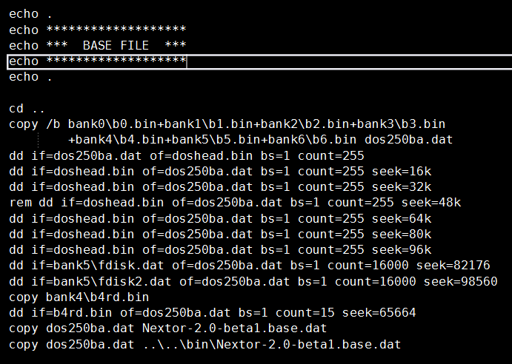
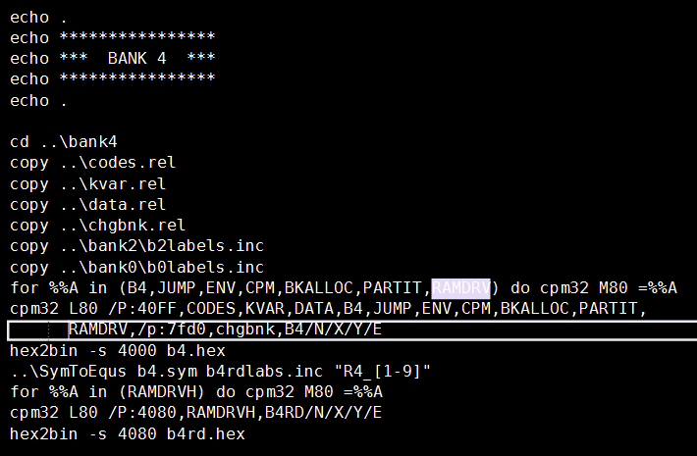
Tools used for the development of Nextor
…and for the compilation: M80 + CP/M emulator + the script of death.
(Bonus: dd for Windows to put all the pieces together)
Notes:
There was a makefile but I didn’t know how to make it work, so I made my own script.
The script has about 250 lines.
The Nextor ROM is 112KB for the kernel + the driver.

Slide 30
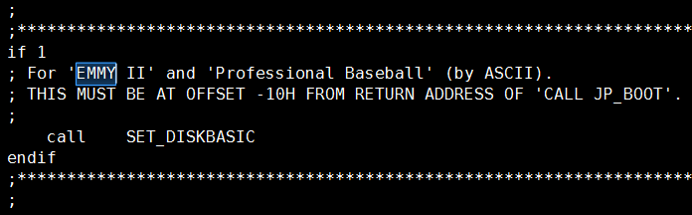

Curiosities
Patching the OS so that a game works (not the other way around!)

Slide 31
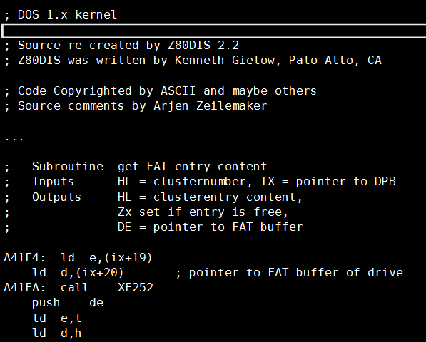

Curiosities
The MSX-DOS 1 sources… disassembled!

Slide 32
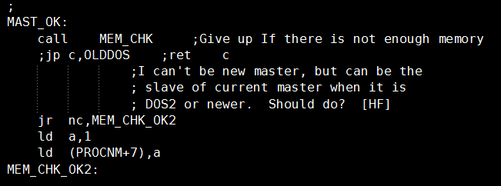
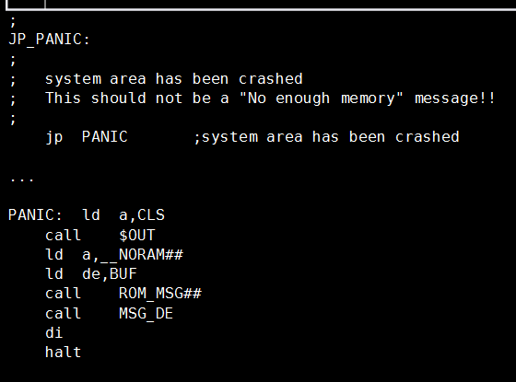

Curiosities
Sometimes the developer wasn’t sure about what he was doing…

Slide 33
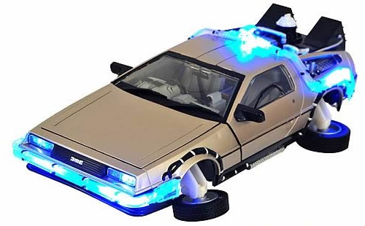
Plans for the future
Current version: 2.0 beta 2
Versions >2.0…
Floppy disk emulation
Using floppy disk images as if they were devices
Filesystem drivers
To use CD-ROMs, network drives…
Loading drivers in RAM

Slide 34

Thank you!
http://www.konamiman.com#nextor

